Slide 1

Terry Bogard
The Legendary Wolf

Slide 2
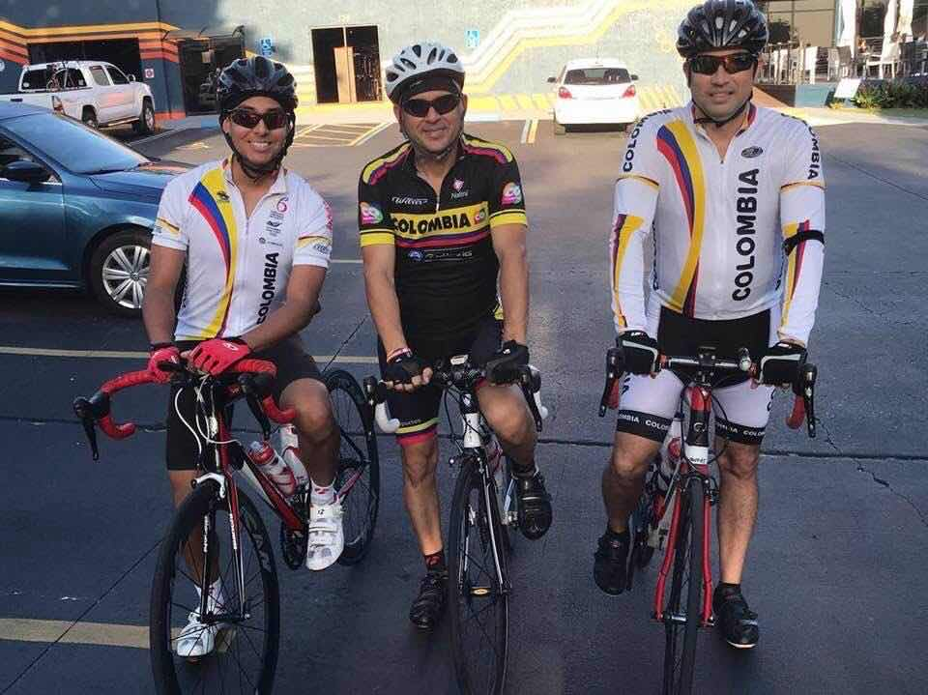
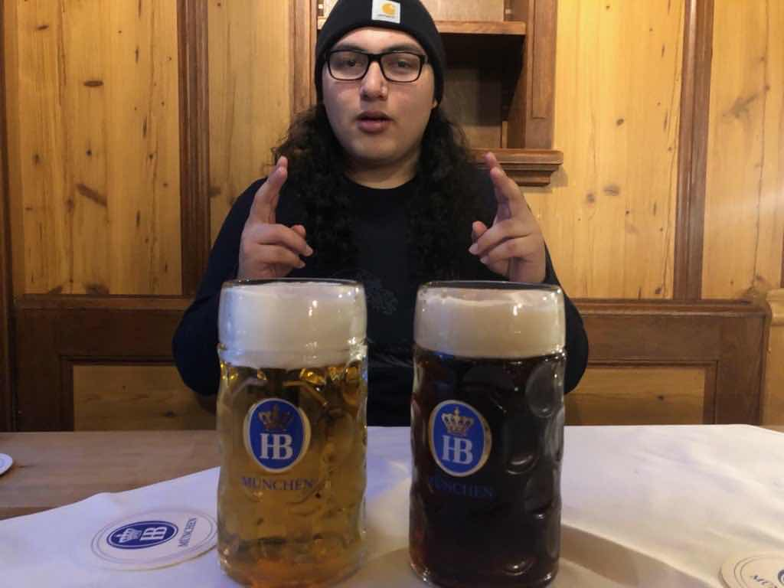
Who are we?
Tomas Marquez
Major: Game Design
Brand: Level Designer
Fun Fact: Cycled 70 miles in one day
Brennen Cruz
Major: Game Design
Brand: Sound Designer
Fun Fact: Went to Germany over the summer

Slide 3
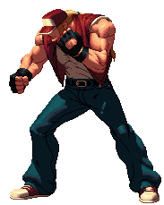
Who is Terry?
Main protagonist of the Fatal Fury series
Has appeared in every Fatal Fury and King of Fighters title
Has appeared in over 80 games over the past three decades
Designed after several Japanese stereotypes of American characters
Token good guy

Slide 4

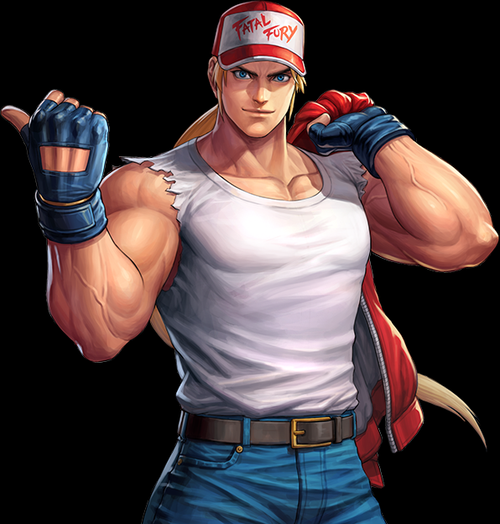
Terry’s Backstory
Terry and his brother, Andy, were orphans raised on the streets
Eventually adopted by Jeff Bogard and raised in South Town
Jeff was killed by Geese Howard
Terry enters King of Fighters tournaments after improving martial arts skills
Terry accidently kills Geese
Terry adopts Geese’s son

Slide 5
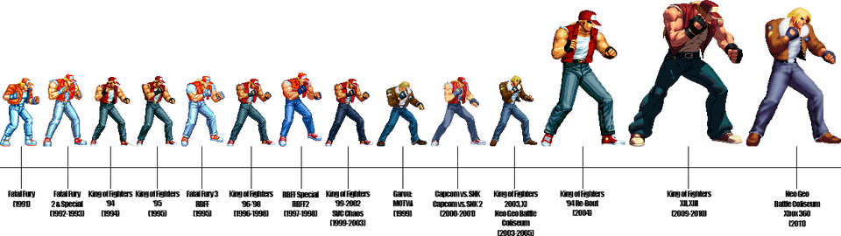
Terry Through the Ages

Slide 6
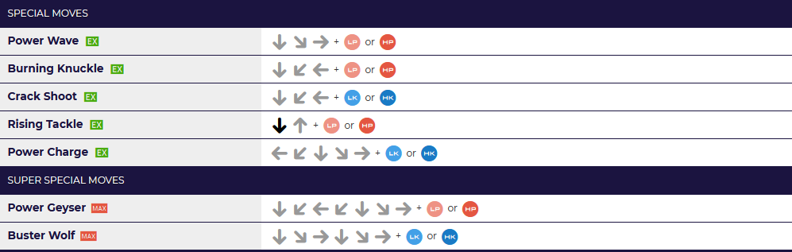

Signature Moves
https://www.inverse.com/article/60711-smash-ultimate-terry-bogard-move-list-moveset

Slide 7
Cultural Impacts
Frequently used as a mascot for SNK in crossover games, merchandising, and publicity
The face of a game series that dominates the Latin American fighting game scene
Is indirectly responsible for games such as Super Smash Bros.

Slide 8
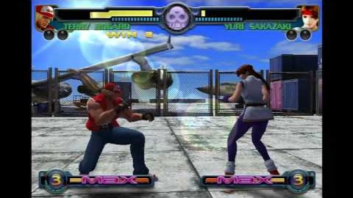
ARE YOU OKAY?!

Slide 9
THANK YOU

